Slide 1
Quick start using a CNCA supercomputer Margarida Madeira e Moura Ilyass Hankrir HPCvLAB@UALGARVE April 11th, 2025

Slide 2
Tools
If using a Microsoft Windows OS:
- MobaXTerm Home Edition (available from https://mobaxterm.mobatek.net/)

Slide 3
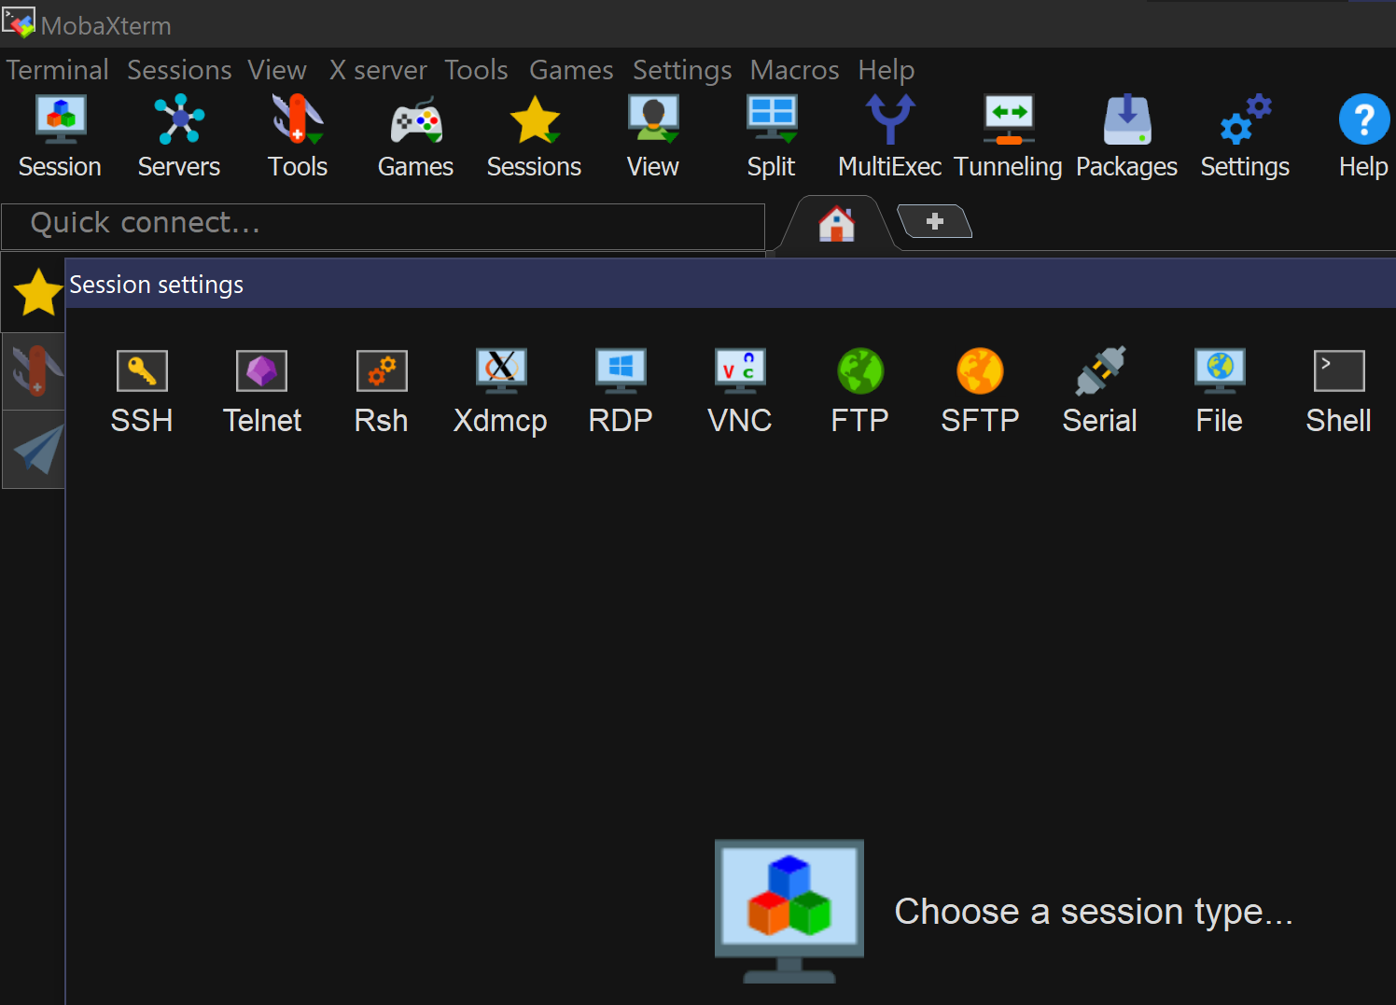
1
2

Slide 4
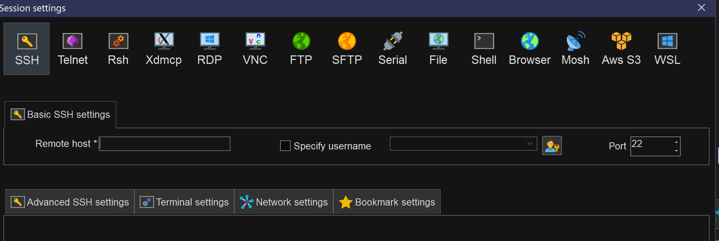
3
4
3 – cirrus.a.incd.pt
4 – the username

Slide 5
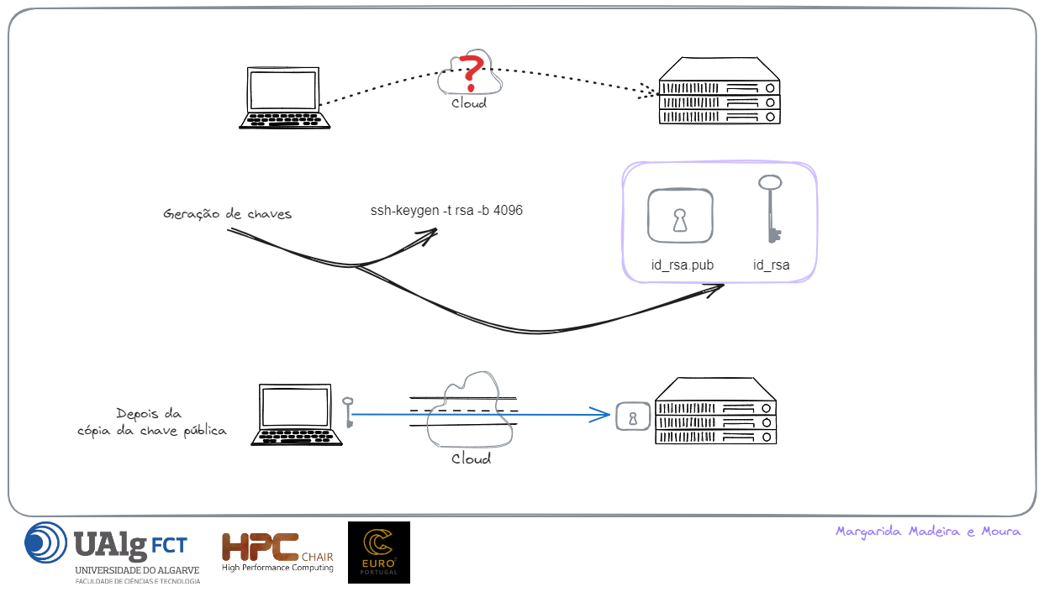

Slide 6
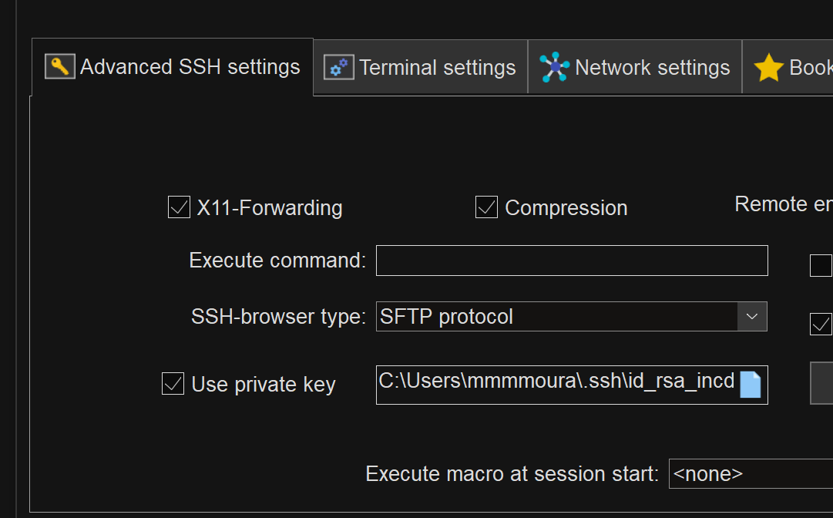
5

Slide 7
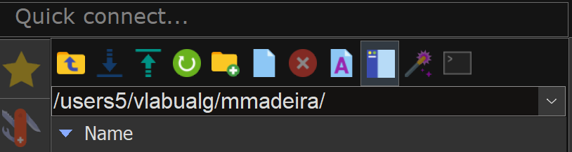
MobaXterm buttons

Slide 8
Tools
If using a Microsoft Windows OS:
- MobaXTerm Home Edition (available from https://mobaxterm.mobatek.net/)
Alternatives for Windows OS/MacOS:
- Visual Studio Code

Slide 9
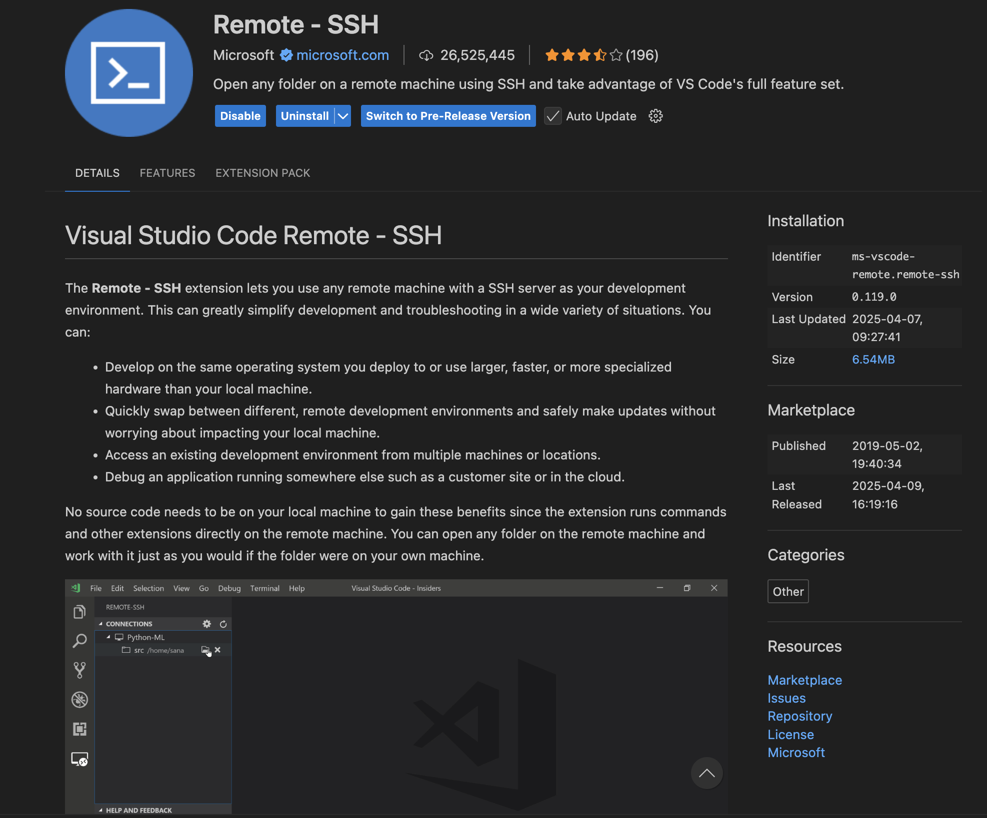
Starting a remote session using VS Code
- Install the following extension if not already installed

Slide 10
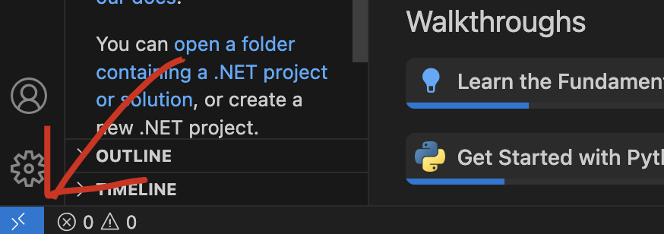
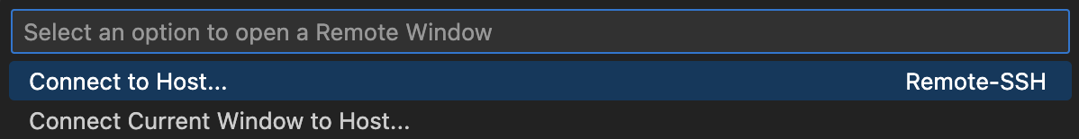
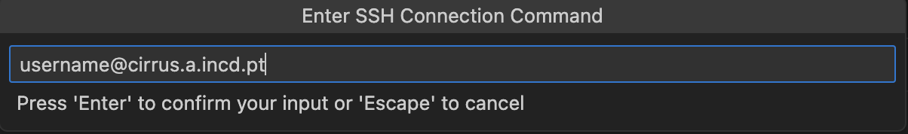
1
2
3

Slide 11
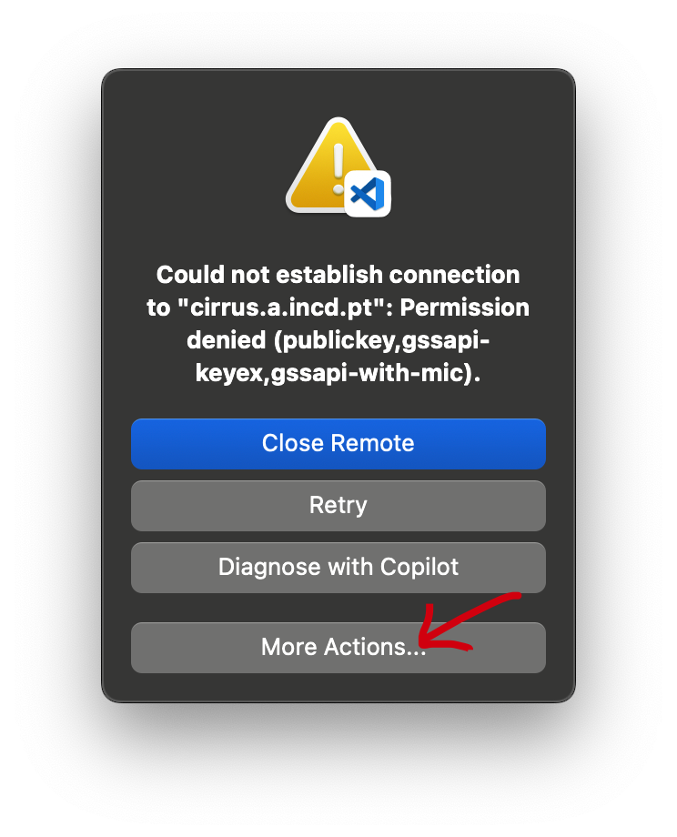
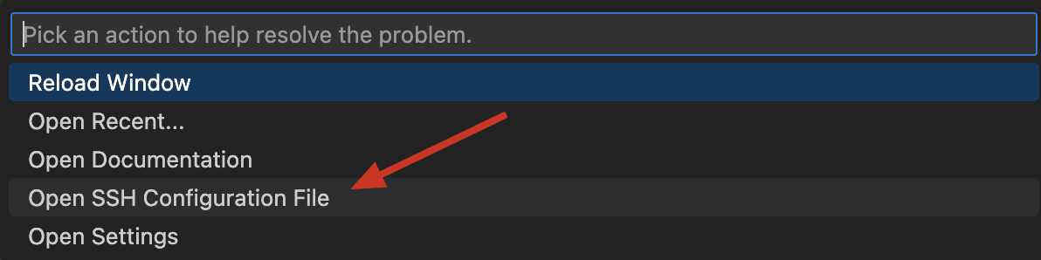
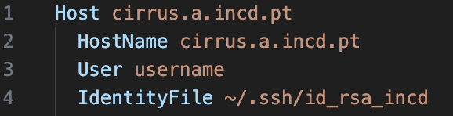
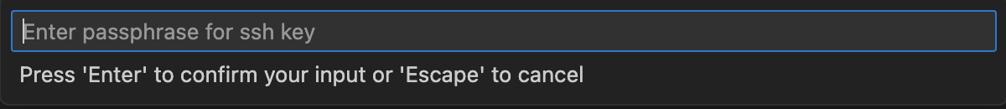
When encountering this error follow these steps:
Make sure your config includes: IdentifyFile ~/Path/To/Private_Key

Slide 12
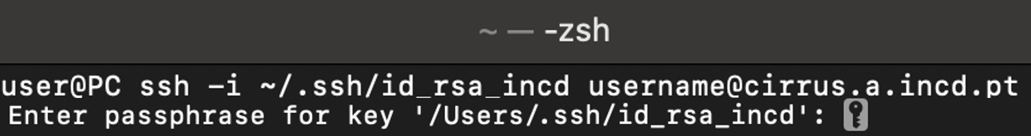
Tools
If using a Microsoft Windows OS:
- MobaXTerm Home Edition (available from https://mobaxterm.mobatek.net/)
Alternatives for Windows OS/MacOS:
- Visual Studio Code
If using the terminal:
Define the username if different from your current user

Slide 13
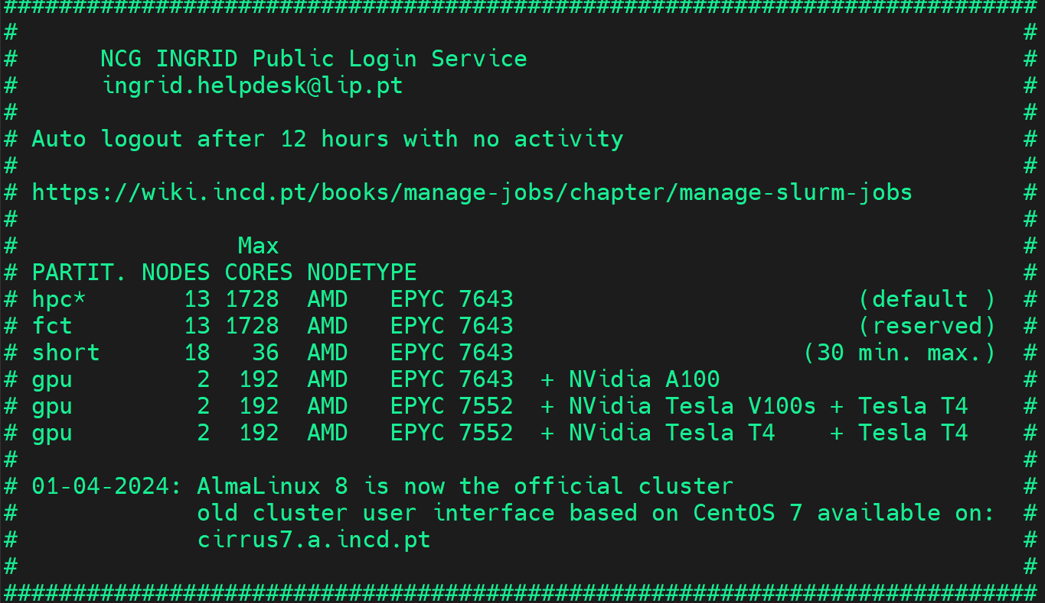
After log in

Slide 14
Environment Management
Cirrus uses environment modules to manage compilers (GCC, Intel), MPI versions, Python, etc.
module avail # show available modules
module spider # search for a module
module load [module] # load a module
module list # list all loaded modules
module unload [module] # unload a module
module purge # unload all modules

Slide 15
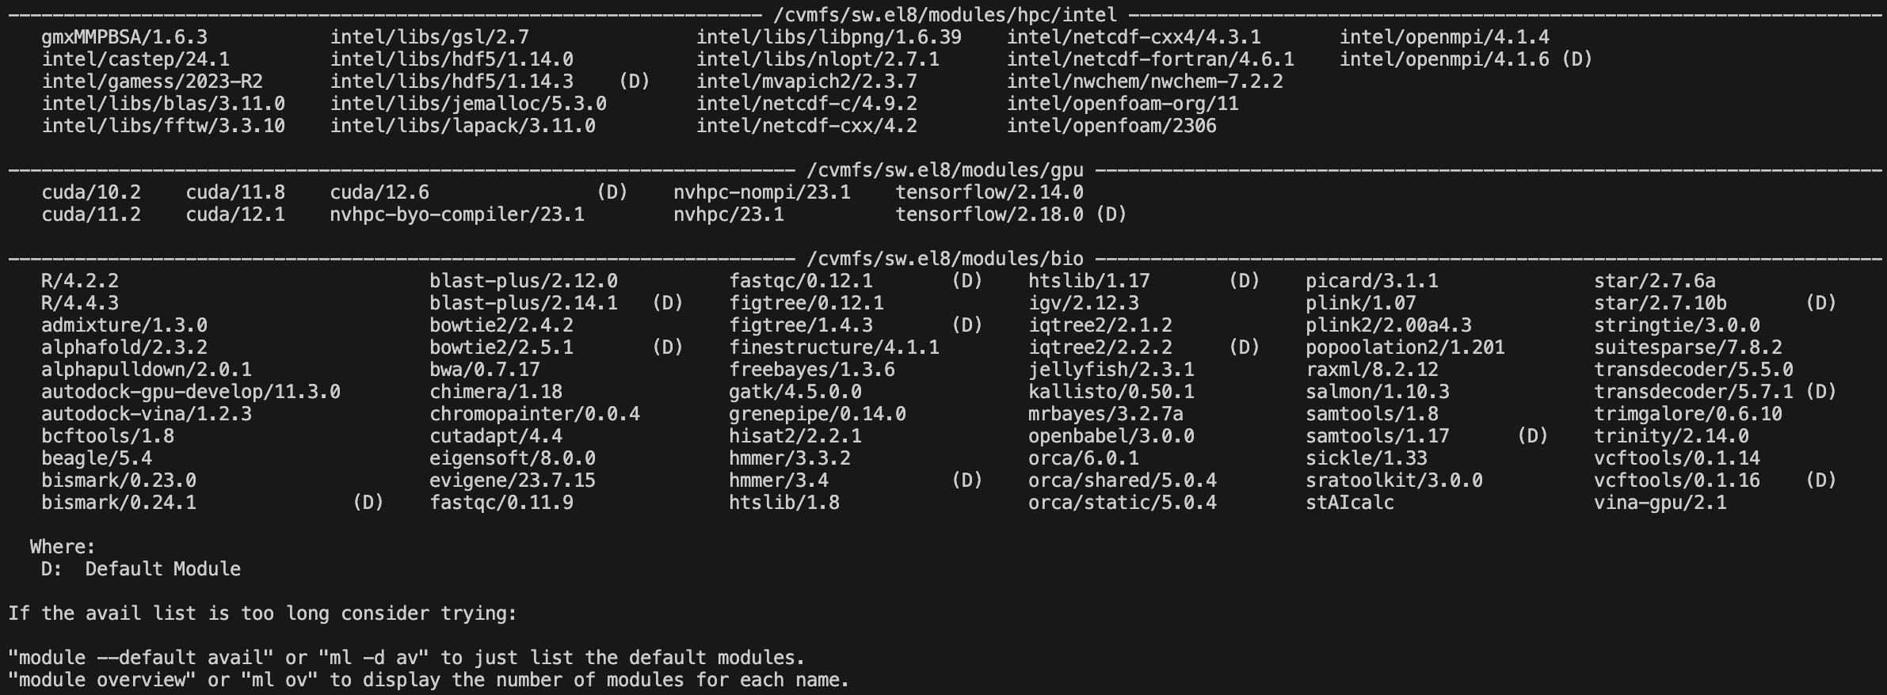
Environment Management
module avail

Slide 16
Environment Management
module avail # show available modules
module spider # search for a module
module load [module] # load a module
module list # list all loaded modules
module unload [module] # unload a module
module purge # unload all modules

Slide 17
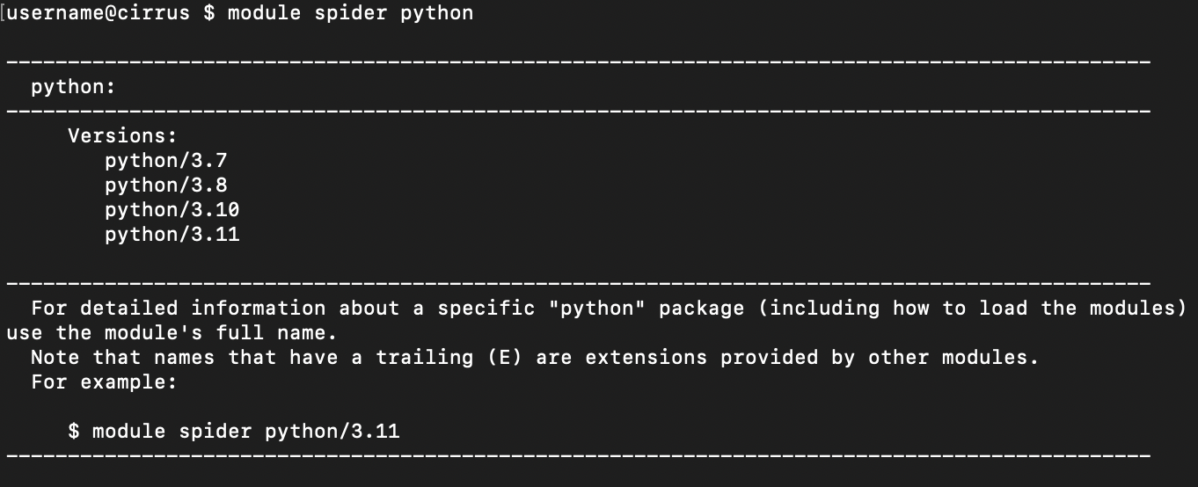
Environment Management
module spider

Slide 18
Environment Management
module avail # show available modules
module spider # search for a module
module load [module] # load a module
module list # list all loaded modules
module unload [module] # unload a module
module purge # unload all modules

Slide 19
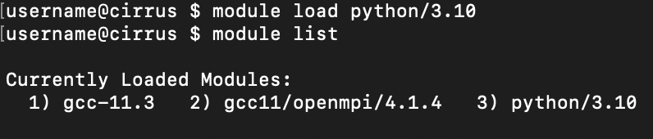
Environment Management
module load + module list

Slide 20
Environment Management
module avail # show available modules
module spider # search for a module
module load [module] # load a module
module list # list all loaded modules
module unload [module] # unload a module
module purge # unload all modules

Slide 21
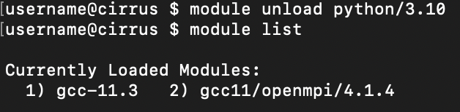
Environment Management
module unload

Slide 22
Environment Management
module avail # show available modules
module spider # search for a module
module load [module] # load a module
module list # list all loaded modules
module unload [module] # unload a module
module purge # unload all modules

Slide 23
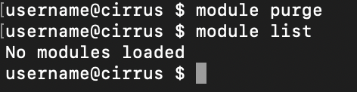
Environment Management
module purge

Slide 24
Examples
Example 1 – distinguishing output from the job script and from the job load
Example 2 – what if something goes wrong: %j.err
Example 3 – MPI in C
Example 4 – OpenMP in C
Example 5 – MPI + OpenMP in C
Example 6 – GPU in C

Slide 25
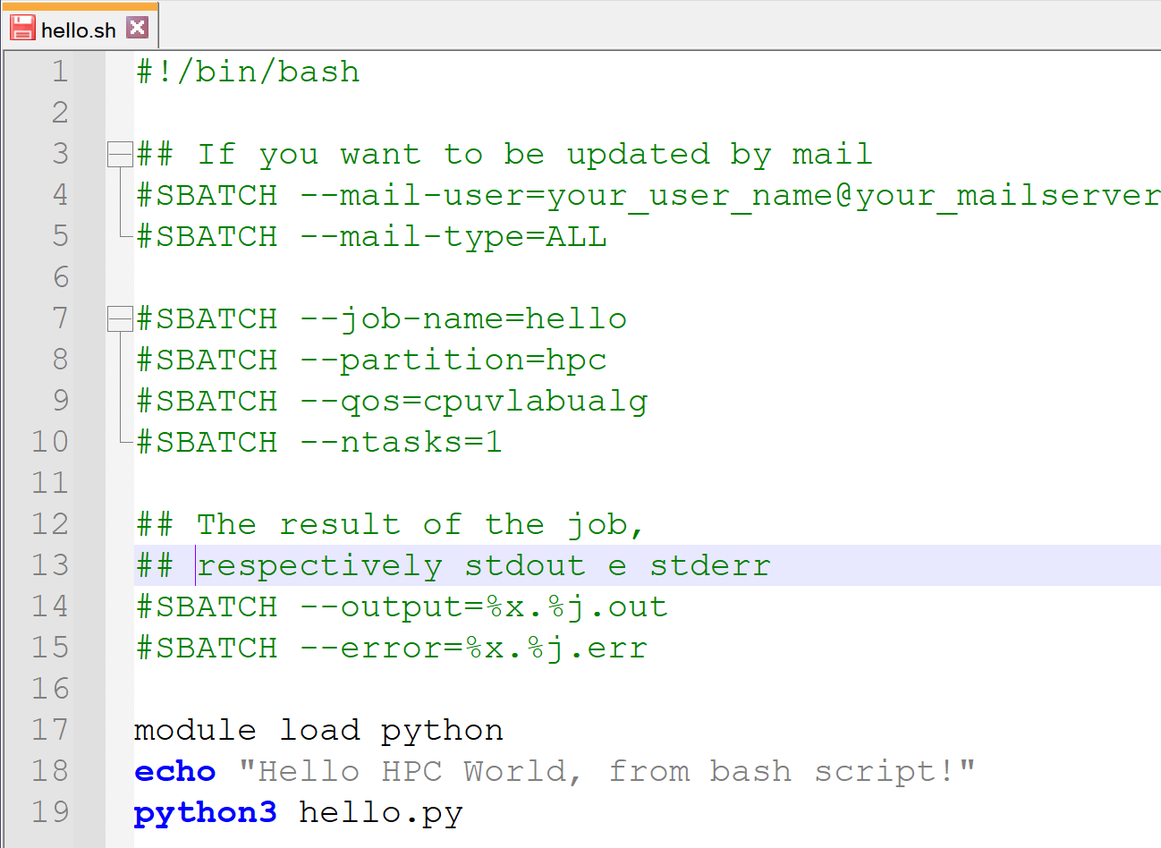
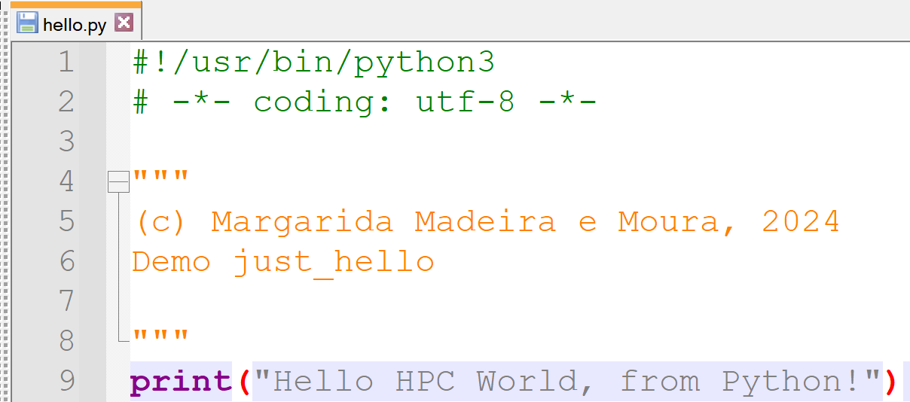
Example 1 – Hello HPC World
Submit your job:
$ sbatch hello.sh

Slide 26
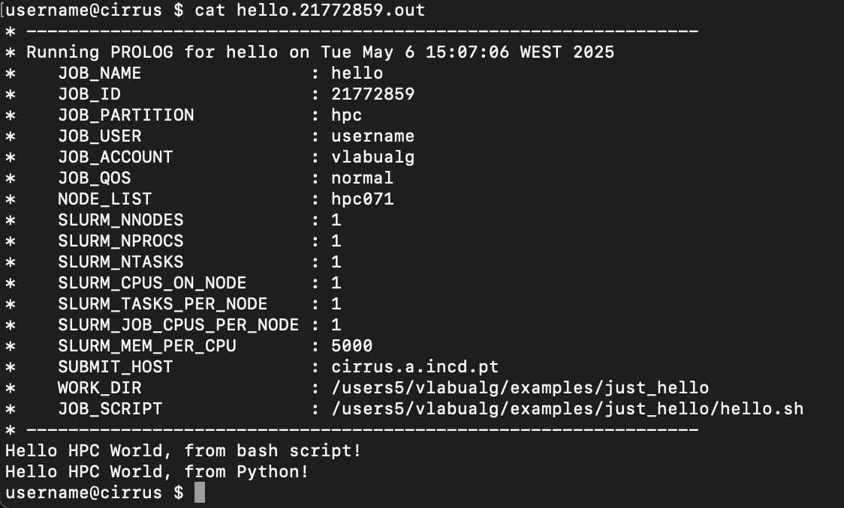
Example 1 – Hello HPC World.out

Slide 27
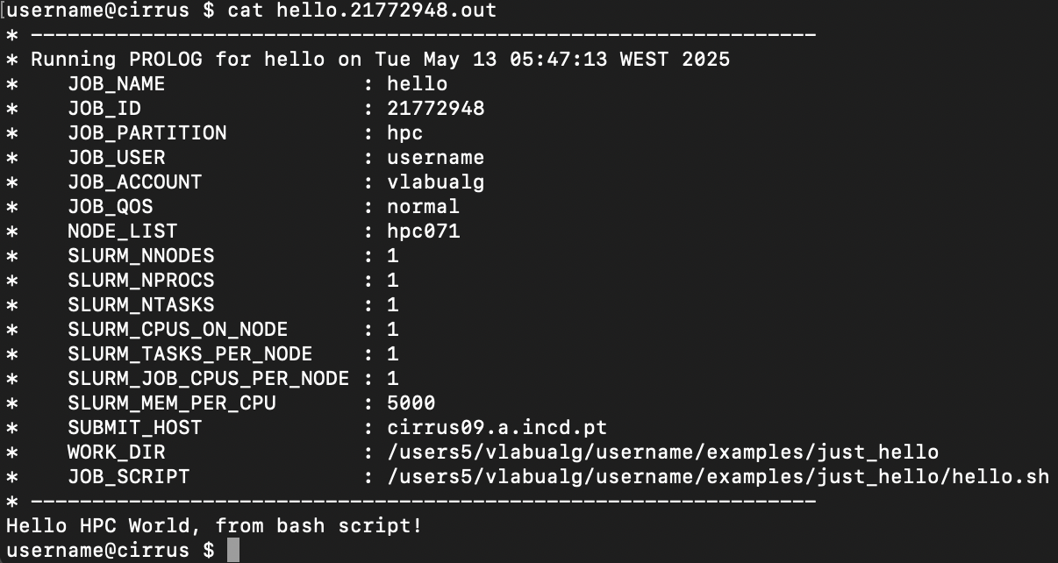
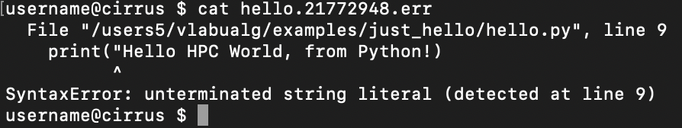
Example 2 – Hello HPC World.err
hello.id.err
hello.id.out

Slide 28
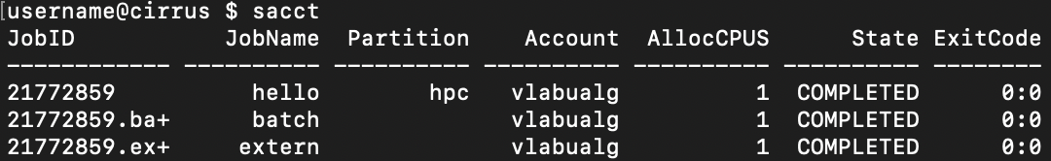
sacct

Slide 29
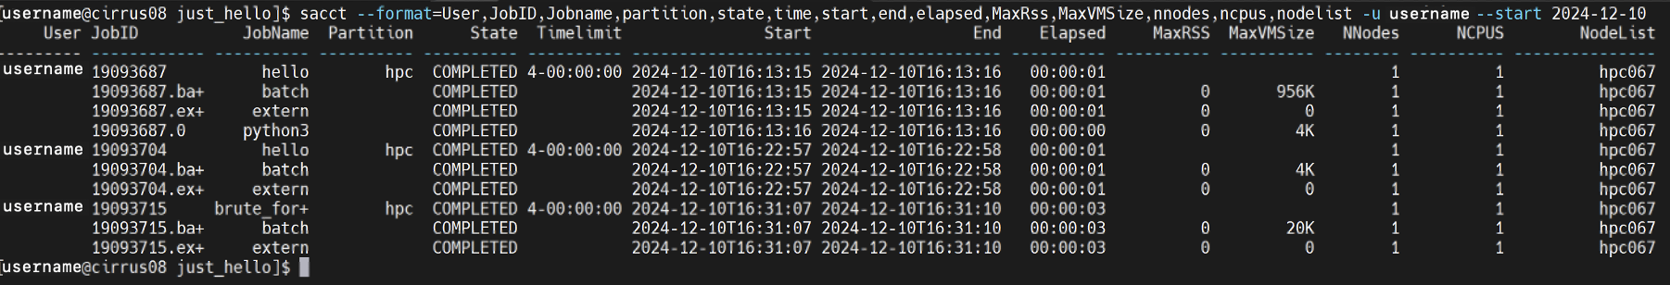
sacct
To list the waiting queue, use:
squeue
To cancel a job, use:
scancel <JOBID>

Slide 30
sacct
To list the waiting queue, use:
squeue
To cancel a job, use:
scancel <JOBID>

Slide 31
Parallel Programming Models: MPI vs OpenMP
Feature | OpenMP | MPI
Memory Model | Shared memory (same node) | Distributed memory (multi-node)
Typical Use | Multithreading | Multiprocessing
Syntax | Pragmas / directives | Function calls
Communication | Implicit (via memory) | Explicit (via messages)
Cirrus Usage Example | --cpus-per-task=4 | --ntasks=4

Slide 32
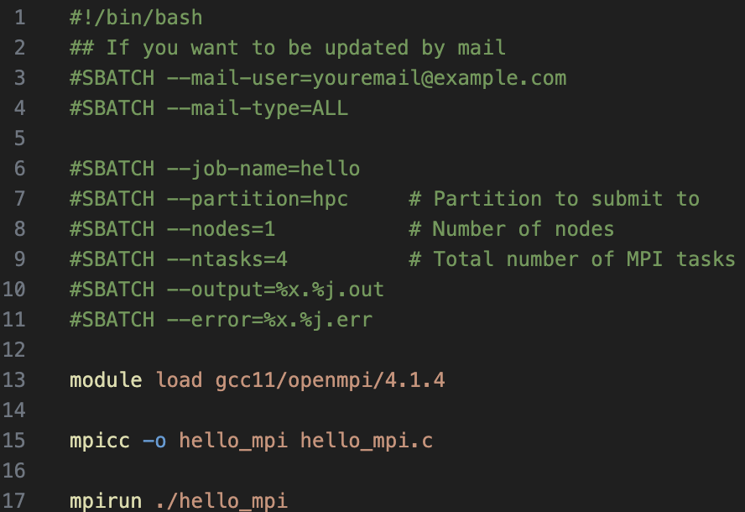
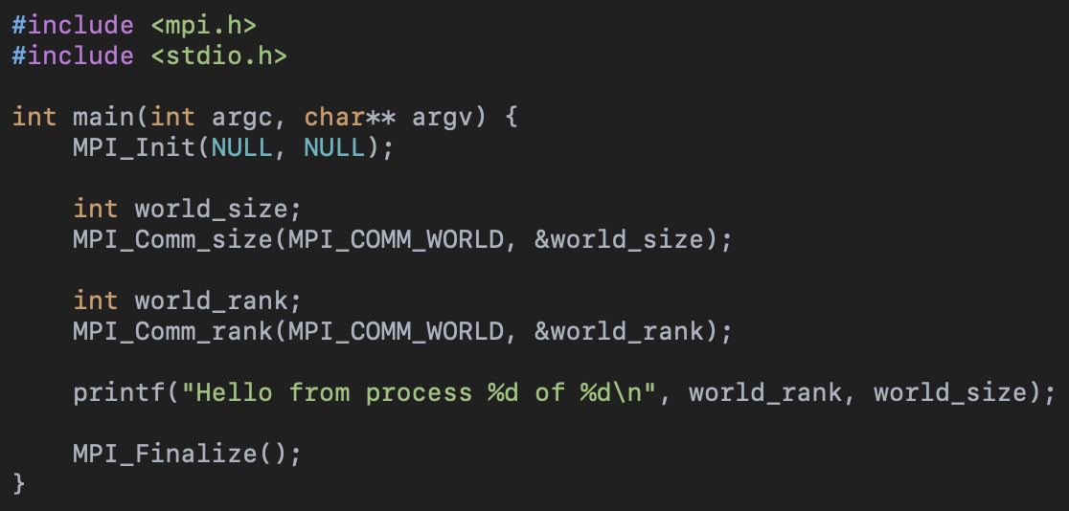
Example 3 – Hello_MPI
Submit your job:
$ sbatch hello_mpi.sh

Slide 33
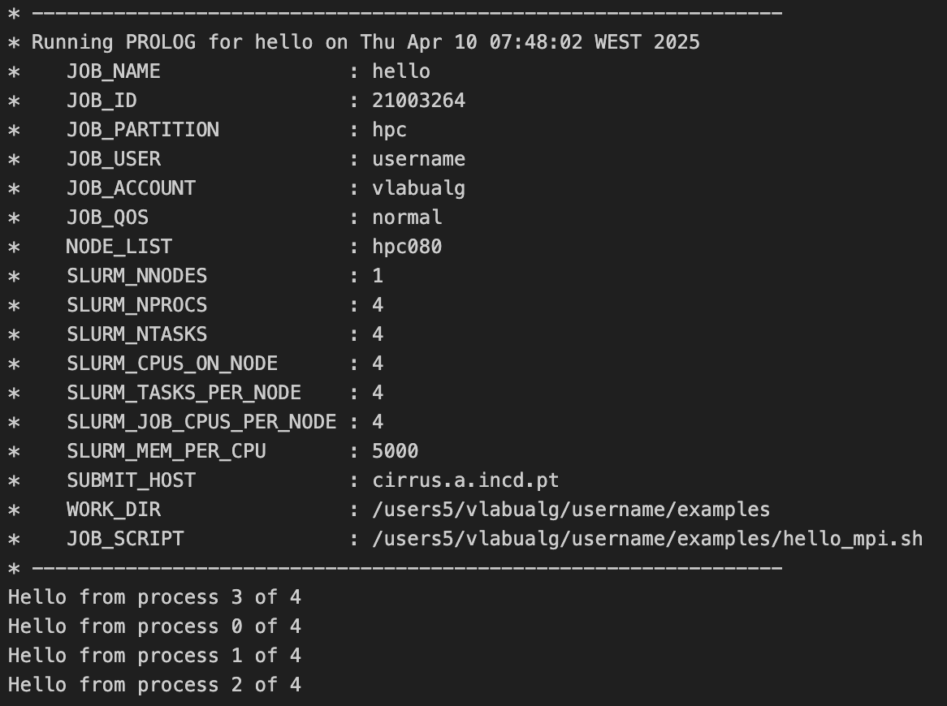
Example 3 – Hello_MPI

Slide 34
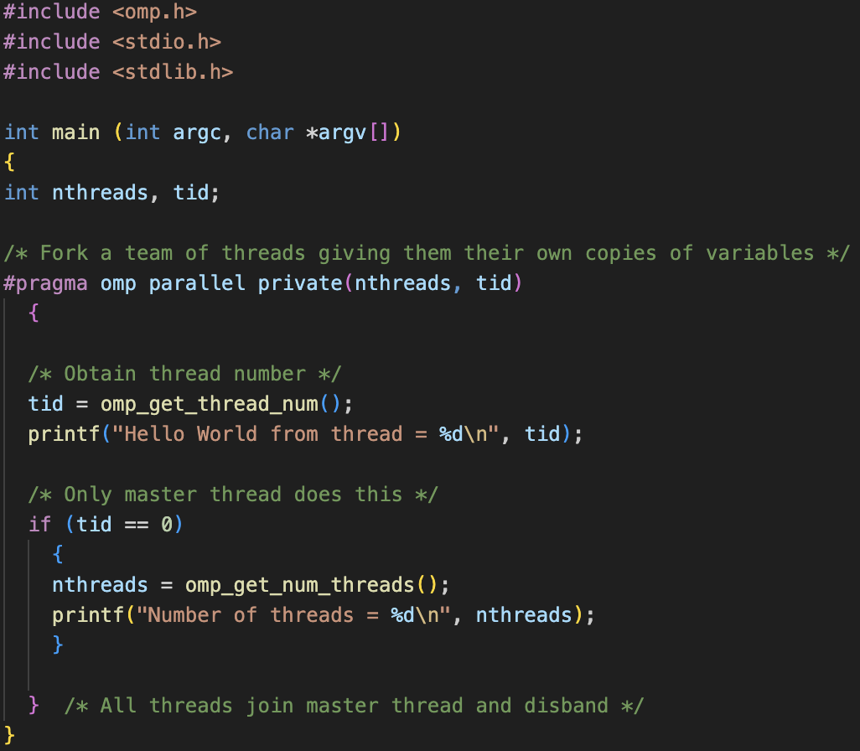
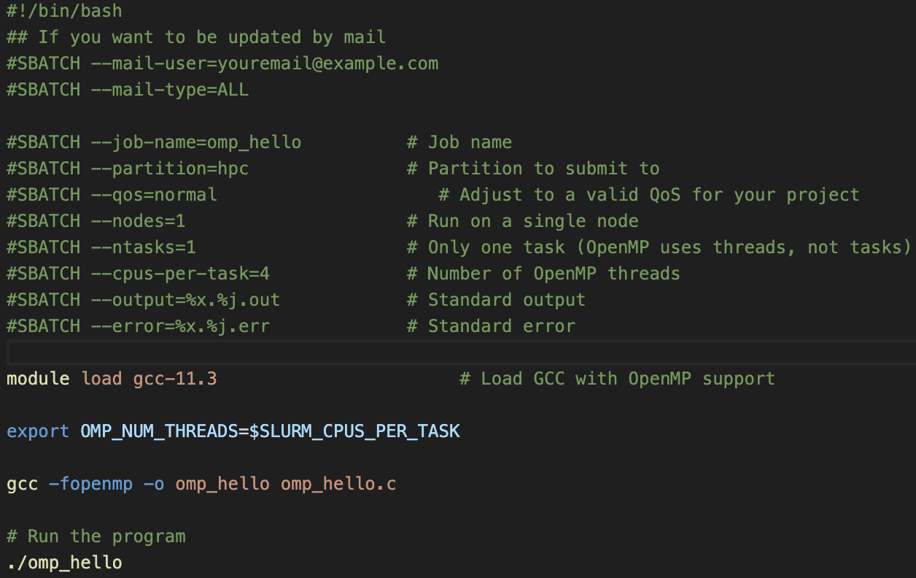
Example 4 – Hello_OpenMP
Submit your job:
$ sbatch omp_hello.sh

Slide 35
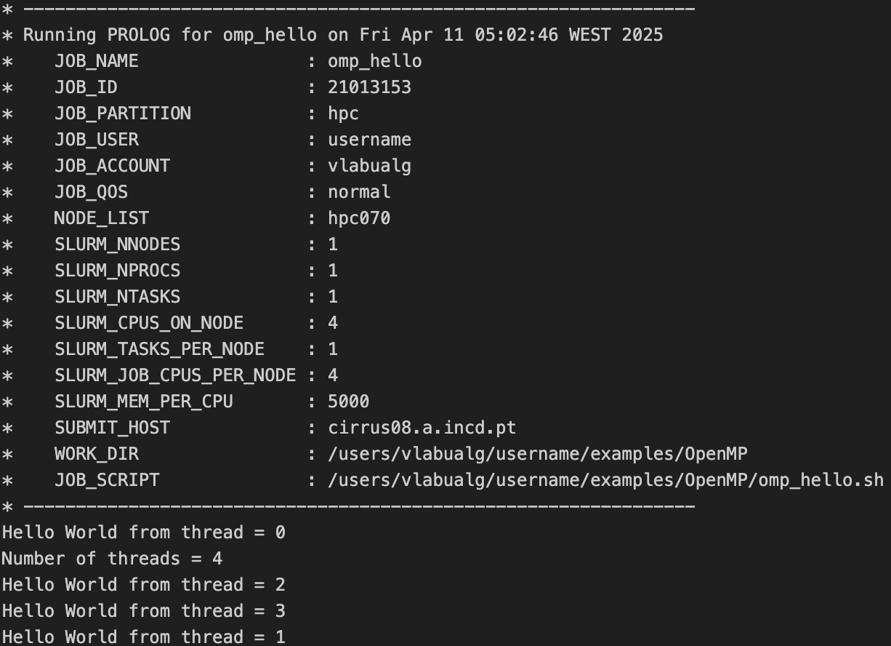
Example 4 – Hello_OpenMP

Slide 36
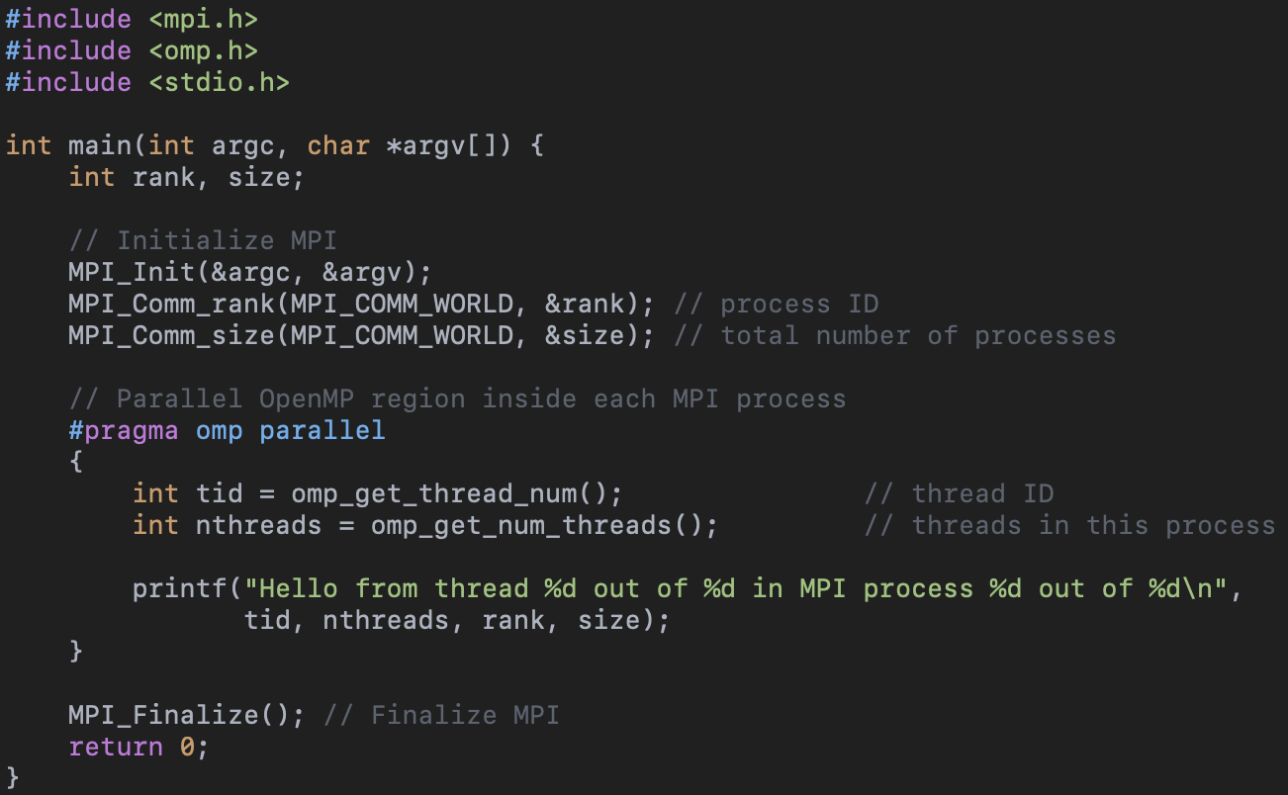
Example 5 – Hello_Hybrid

Slide 37
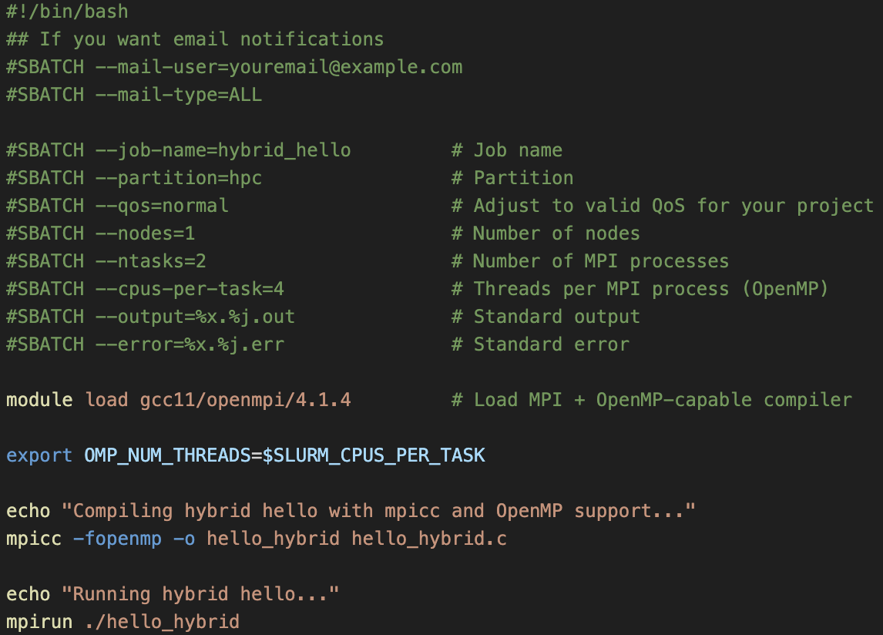
Example 5 – Hello_Hybrid
Submit your job:
$ sbatch hello_hybrid.sh

Slide 38
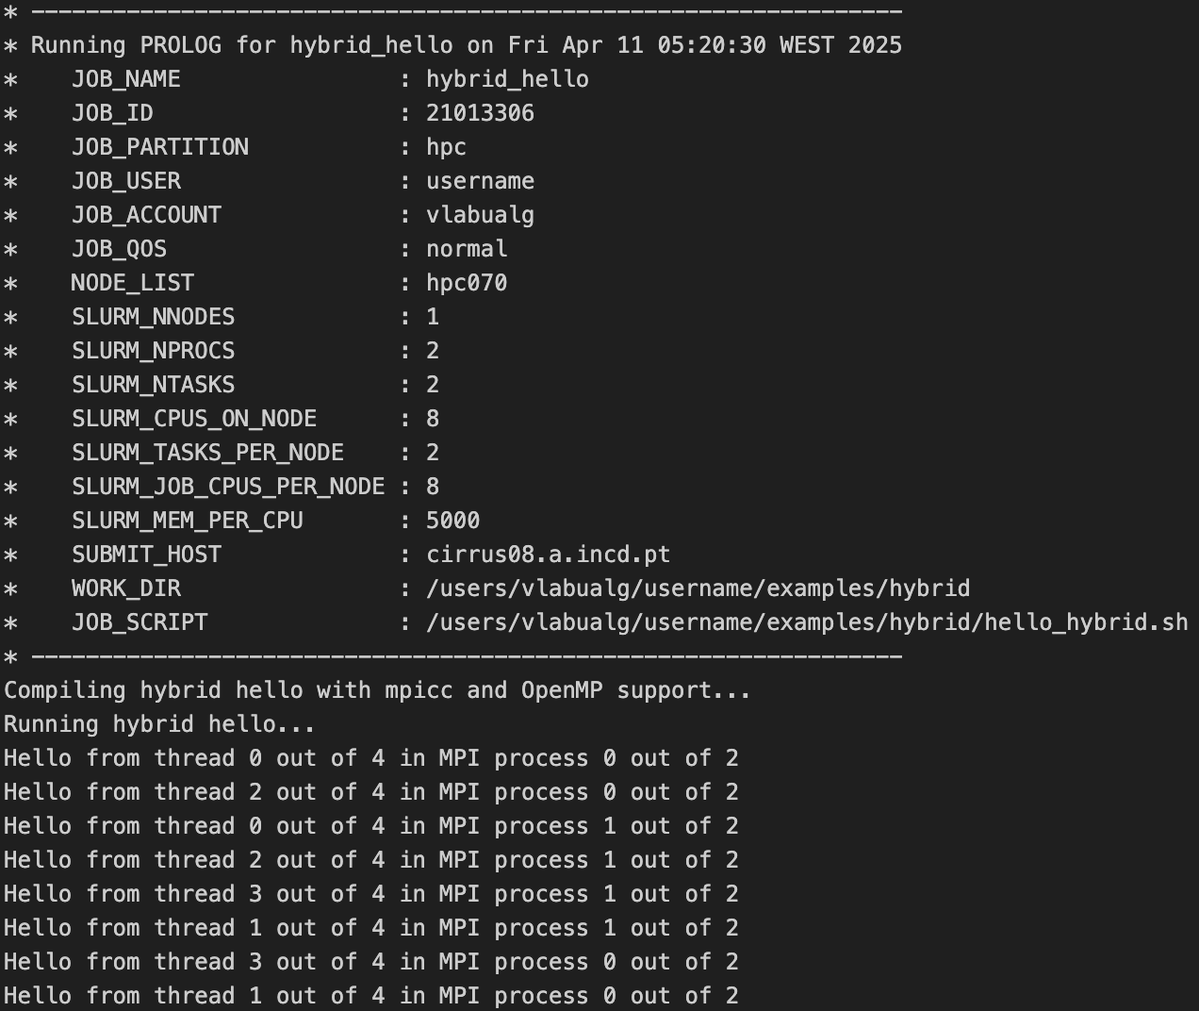
Example 5 – Hello_Hybrid

Slide 39
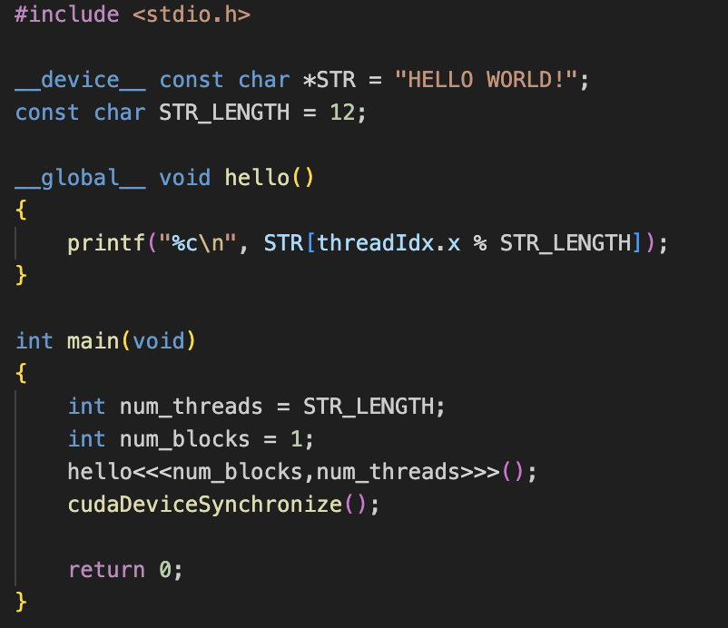
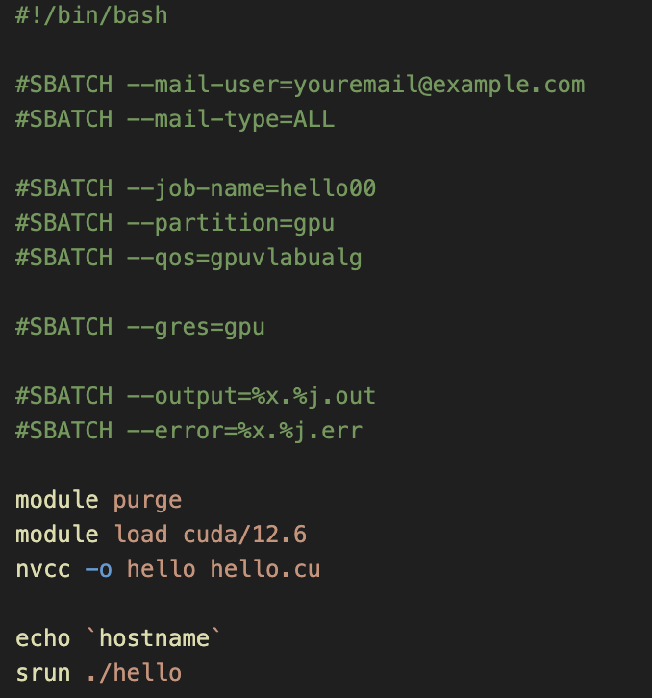
Example 6 – Hello_GPU
Submit your job:
$ sbatch hello.sh

Slide 40
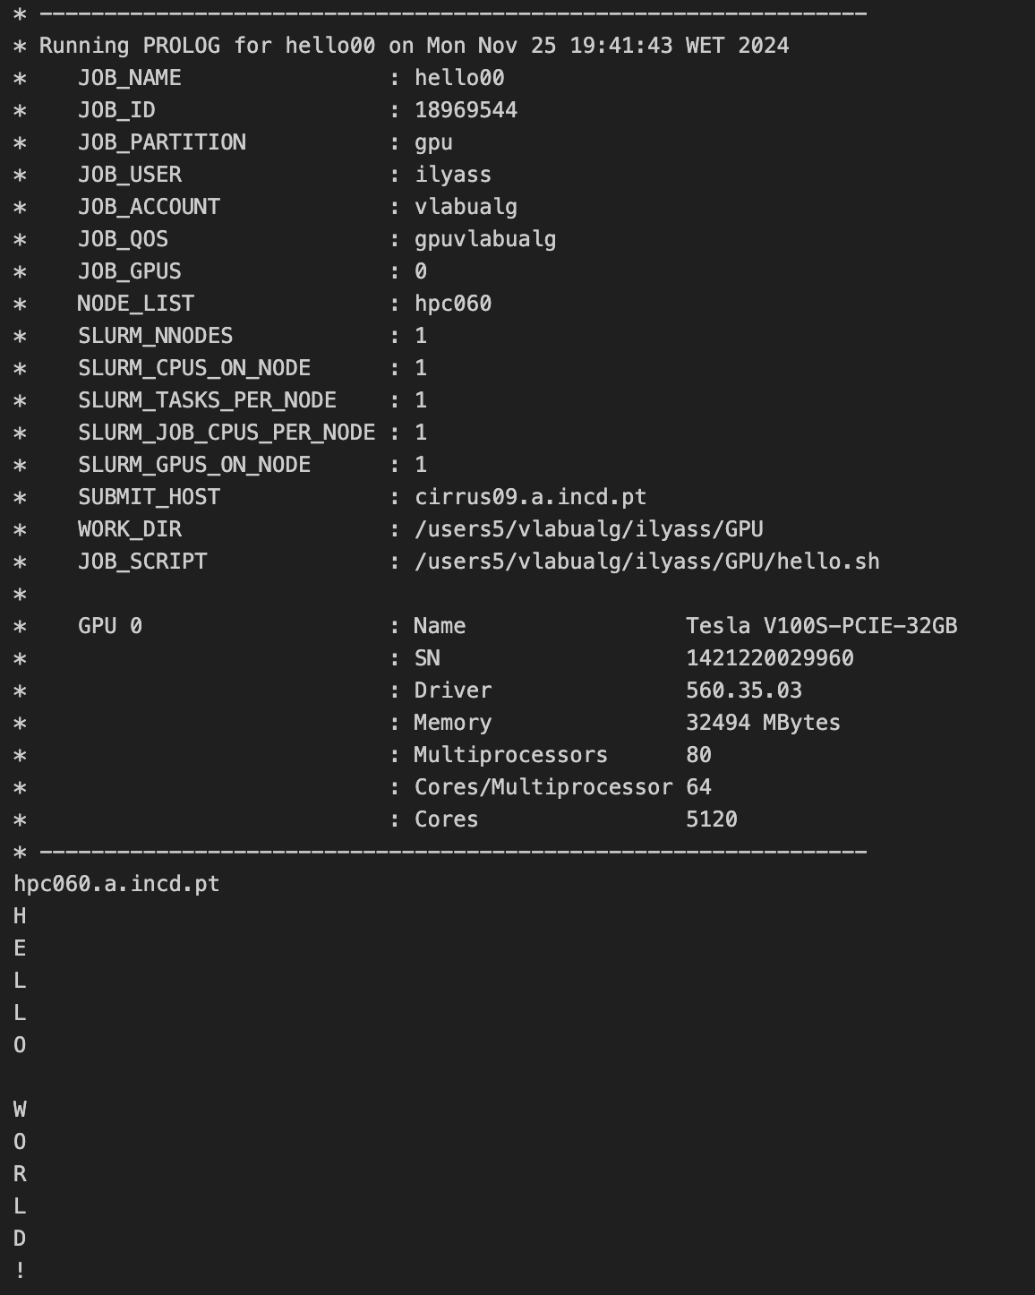
Example 6 – Hello_GPU

Slide 41
References
Software used in the presentation:
mobaxterm, vscode
Environment software
Python
Mpi
Openmp
CUDA
Codes from:
https://developer.nvidia.com/cuda-education
https://hpc-tutorials.llnl.gov/

Slide 42
Acknowledgements This initiative is supported by the project “NATIONAL COMPETENCE CENTRES IN THE FRAMEWORK OF EUROHPC PHASE 2 – EUROCC2”, funded by Fundação para a Ciência e Tecnologia, I.P., and “DIGITAL-EUROHPC-JU-2022-NCC-01” da European High-Performance Computing Joint Undertaking ('JU’) and makes use of Cirrus supercomputer of CNCA - National Distributed Computing Infrastructure. Examples adapted from LLNL HPC Tutorials

